Slide 1
Skin Disease Detection using Image Processing and
Data Mining
Mentor
Jayashree Hajgude
Group Members
Harsha Achara (01)
Aishwarya Bhavsar (17)
Nisha Khubchandani (45)

Slide 2
PROBLEM STATEMENT
Skin diseases are becoming common nowadays.
Most skin diseases tend to affect by airborne transmission.
It is important to control it at initial stages to prevent it from spreading.
Currently, most of the people visit dermatologist for determining whether they have been affected by skin disease or not and also for detection of their disease.
Thus, we are aiming to develop a mobile application for detecting skin diseases which allows user to identify human skin disease based on the techniques of image processing and data mining where multiple users can access mobile application with no cost and also to increase the awareness of skin diseases on what it may do to our bodies which will lead to death or infecting other people and have a cure before it gets worse.

Slide 3
Expected Outcomes
The primary objective is to control the most common skin diseases which are eczema, impetigo, melanoma at initial stages so as to prevent it from spreading.
The system should be able to classify the skin diseases from the above three common diseases depending on the image and symptoms uploaded by the user.
The system should be able to provide the most accurate results where multiple users can access it nearly at no cost.
It is an mobile application so it can be accessed by most of the hospitals even in the remote locations of the country.
Users can get some prior knowledge of their skin disease without visiting to dermatologist.
In most developing countries, it is expensive for a large number of people to consult a dermatologist hence android mobile applications can be used to determine the skin disease with time feasibility and less time complexity.

Slide 4
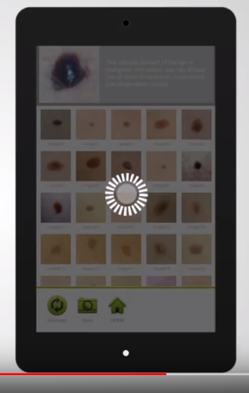
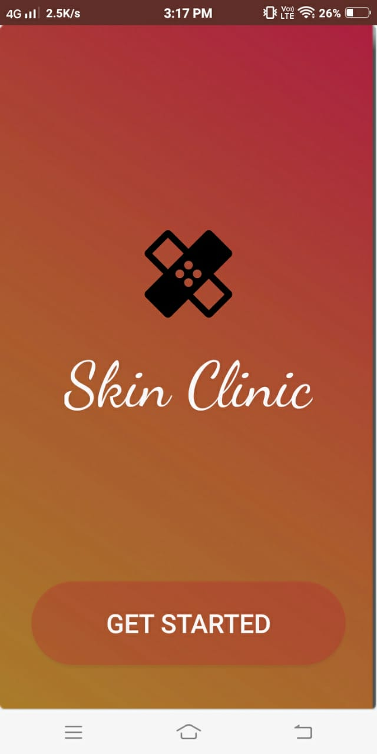
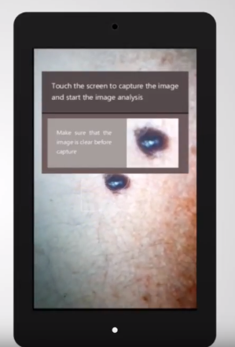
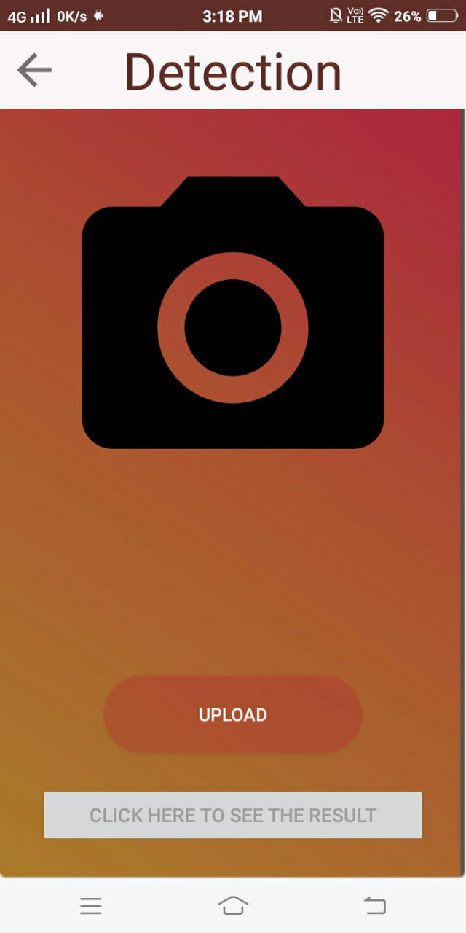
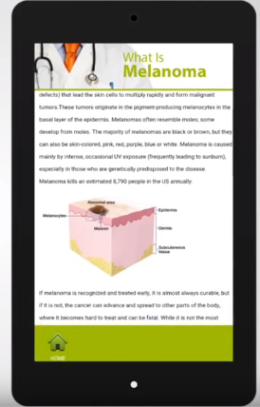
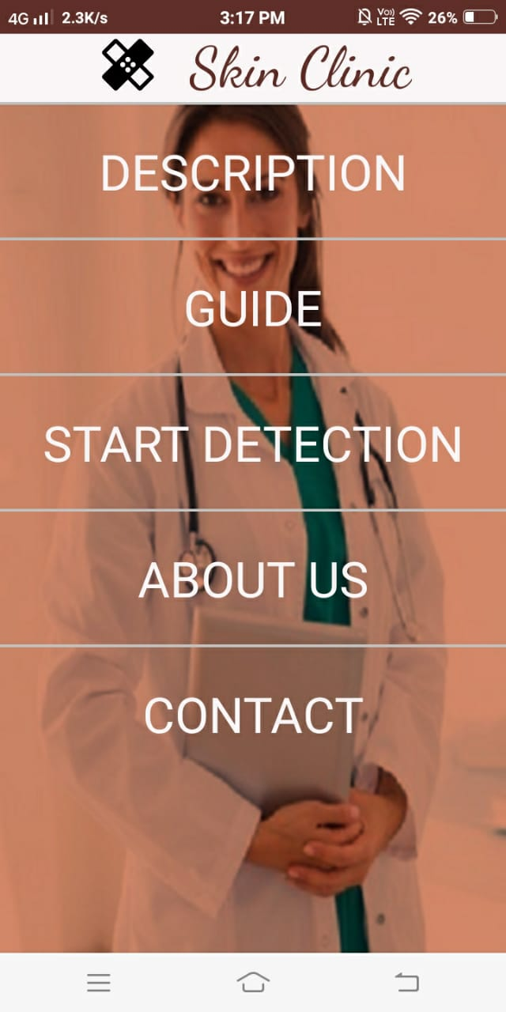

Slide 5
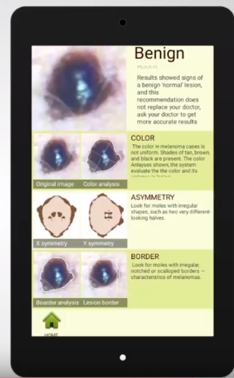
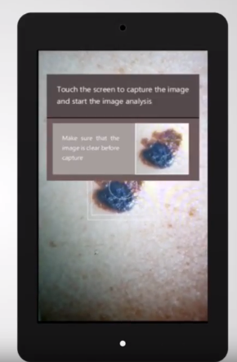
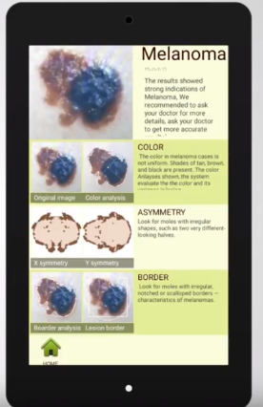
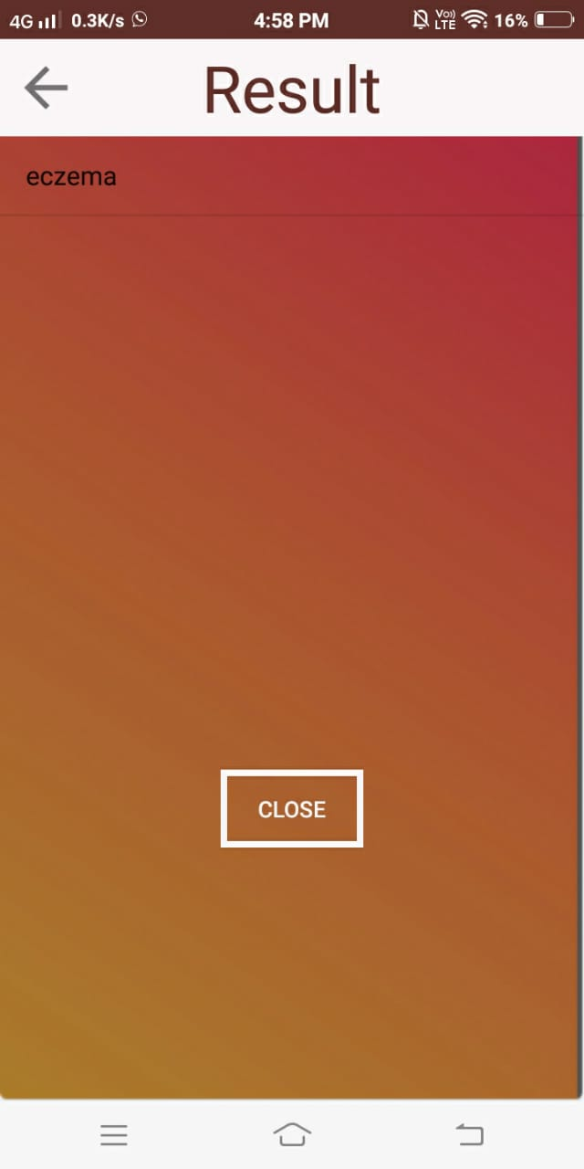
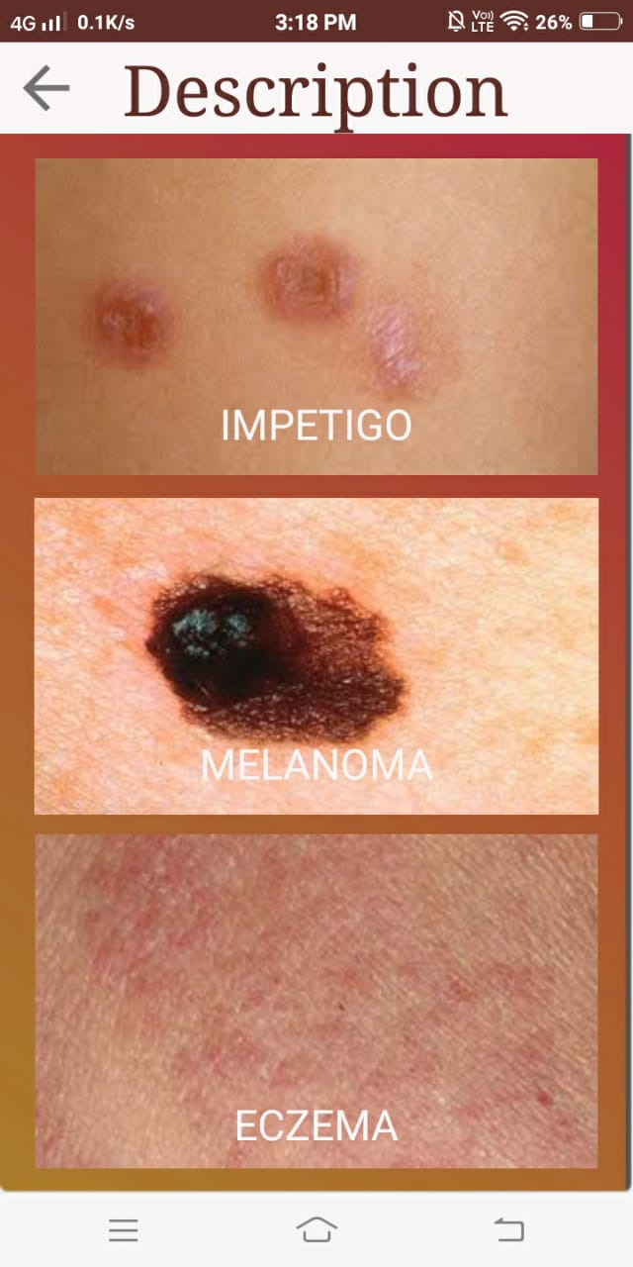
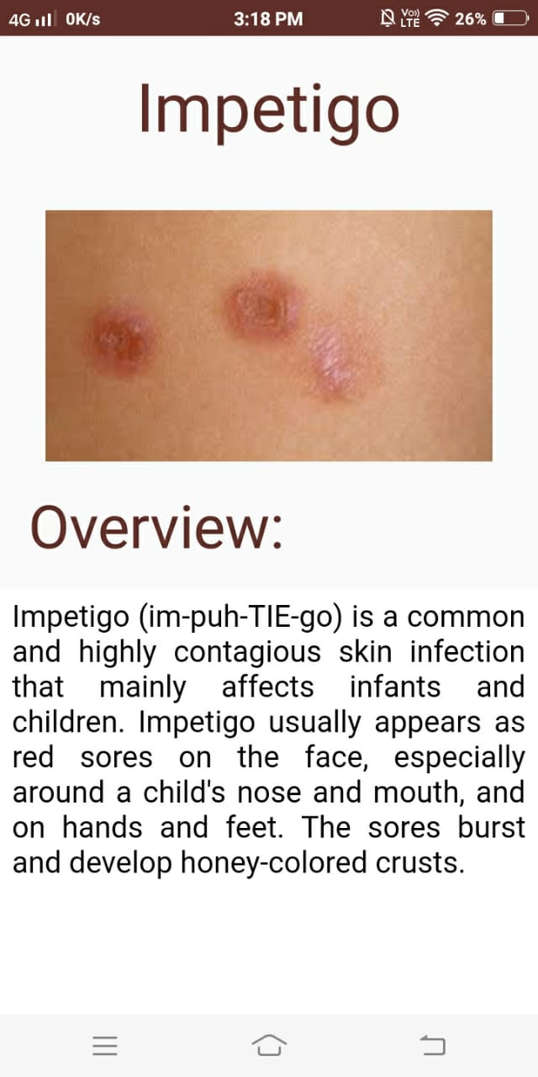

Slide 6
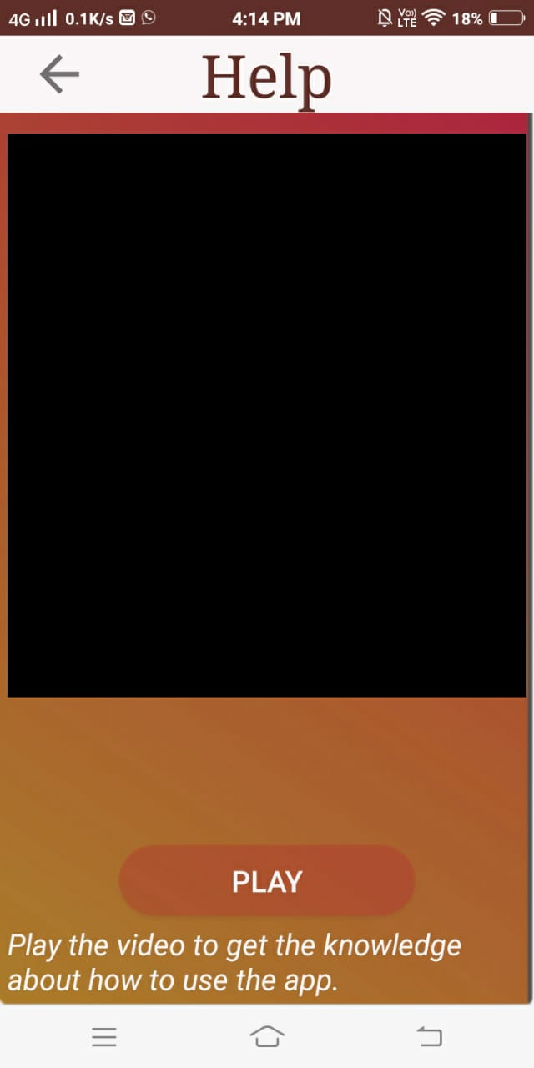
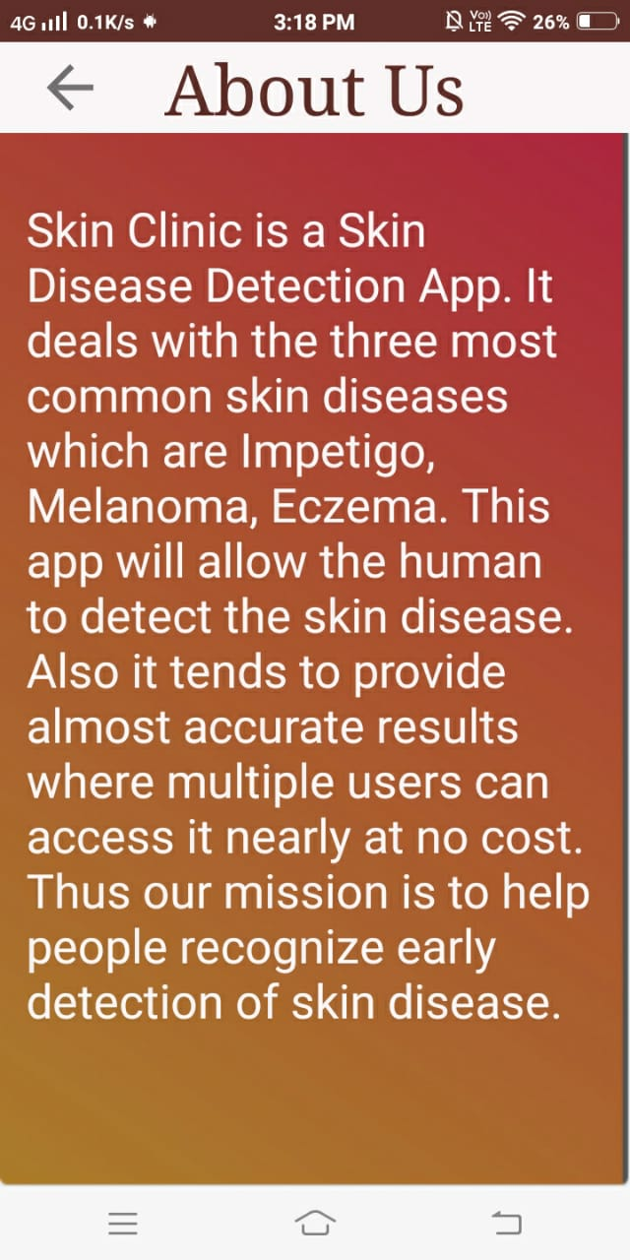

Slide 7
Literature Survey

Slide 8
Title | Author | Publication Details | Summary
An Innovative Approach for Skin Disease Detection Using Image Processing and Data Mining | [1]Er.Shrinidhi Gindhi, [2]Ansari Nausheen, [3]Ansari Zoya, [4]Shaikh Ruhin | International Journal of Innovative Research in Computer And Communication Engineering April 2017 | Diagnosis methodology uses Digital Image Processing in Matlab. Segmentation using histogram analysis.
Skin Diseases Detection Models using Image Processing: A Survey | Nisha Yadav, Virender Kumar Narang, Utpal shrivastava | International Journal of Computer Applications (0975 – 8887) Volume 137 – No.12, March 2016 | This application is implemented only for three skin diseases (Eczema, Impetigo and Melanoma). Image Segmentation using thresholding method.
Expert System For Diagnosis Of Skin Diseases | A.A.L.C. Amarathunga, E.P.W.C. Ellawala, G.N. Abeysekara, C. R. J. Amalraj | INTERNATIONAL JOURNAL OF SCIENTIFIC & TECHNOLOGY RESEARCH VOLUME 4, ISSUE 01, JANUARY 2015 | Filtering of the image is done using Median filter and gaussian filtering. Various Classification algorithms are compared among these, MLP and the J48 gave us more reliable prediction.

Slide 9
Title | Author | Publication Details | Summary
Implementation of ANN Classifier using MATLAB for Skin Cancer Detection | Aswin.R.B1, J. Abdul Jaleel2 Sibi Salim3 | International Journal of Computer Science and Mobile Computing, December 17-18, 2013 at Trivandrum, Kerala | Dull Razor Software for hair removal, Filtering used is median filtering, Image segmenation using minimum error threshold, Segmentation is performed using ImageJ software, Feature extraction using 2d wavelet in MATLAB.
Dermatological Disease Detection using Image Processing and Artificial Neural Network | Rahat Yasir,,* Md. Ashiqur Rahman, and Nova Ahmed | 8th International Conference on Electrical and Computer Engineering 20-22 December, 2014, Dhaka, Bangladesh | Preprocessing is done using grey image, sharpening filter, median filter, smooth filter. For feature extraction sobel operator is used.

Slide 10
Architectural Design/Detailed Design.

Slide 11
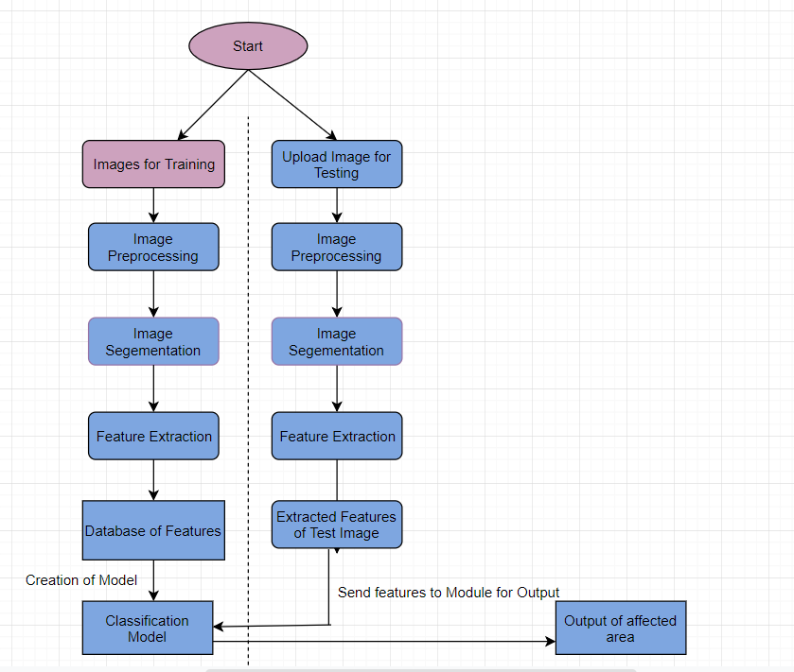
Flowchart

Slide 12
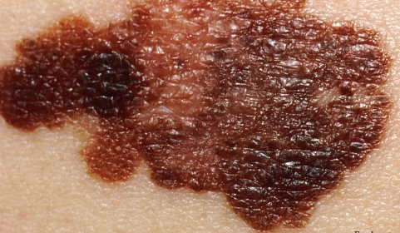
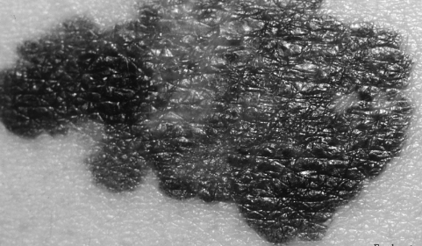
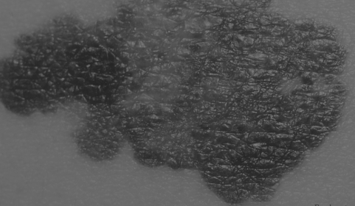
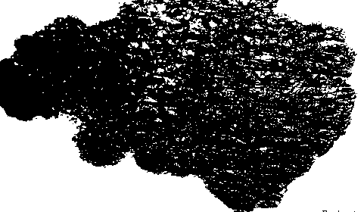
Proposed system mainly consists of these components:
A. Image processing unit.
1) Preprocessing of image: The image contains hairs and other noises. These noises cause errors in classification. The noises are removed by filtering. Filtering method implemented here is the Median Filtering.
2) Image Segmentation: The image after filtering is subjected to segmentation. Segmentation separates the suspicious lesion from normal skin. To separate the healthy skin from disease here the concept called Multilevel thresholding using otsu in image processing is applied.
3) Feature Extraction: After performing the segmentation, finally features (Texture and Statistical features) of skin disease image will be extracted using 2D Wavelet Transformation and GLCM.

Slide 13
Features Extracted
Statistical Features
Texture Features
Entropy
Mean
Mean Absolute Deviation
Median Absolute Deviation
Energy
Standard Deviation
L1 Norm
L2 Norm
Kurtosis
Skewness
Contrast
Correlation
Energy
Homogeneity

Slide 14
B. Data mining unit
The results obtained from the image processing unit will be examined and the disease will be identified and displayed by this unit.
1) Classification: For this, both CNN and SVM classifiers are used for detection of skin disease. Also analysis is made based on accuracy of both classifiers.
2) Result: Finally using this data mining classification model, our system will detect skin disease.

Slide 15
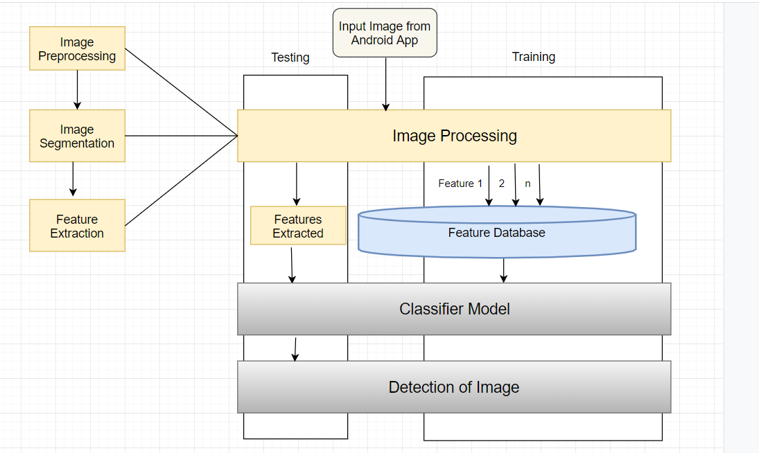
System Architecture

Slide 16
TECHNOLOGY STACK
Hardware requirements:
Camera,
PC/Laptops,
Android Mobile (minimum 3gb Ram and >=5 megapixel back camera) for input and output.
Software requirements:
MATLAB
Android Studio for mobile app development,
Mysql for database,
XML for designing the UI
Xampp Software for Server setup and php for integration

Slide 17
SCOPE
This Mobile application will be implemented only for three skin diseases (Eczema, Impetigo and Melanoma).
This Mobile Application will be developed only for Android OS.
It only supports English language not for other ordinary languages like Sinhala, Tamil.
In future, this application can be extended for detection of various skin diseases and it can be developed for windows as well as IOS operating systems.

Slide 18
Research Area:
CNN Implementation:
Convolution2DLayer: ReLU Layer: Rectified Linear Unit Layer. Introduces non-linearity in the ConvNet.
MaxPooling Layer: It divides the input into rectangular regions and computes the maxima of each region.
Fully Completed Layer: Multiplies an input with weight matrix and adds bias vector.
Softmax Layer: It is a logistic activation function which is used for multiclass classification.
Classification Layer: Performs the classification and gives output.

Slide 19
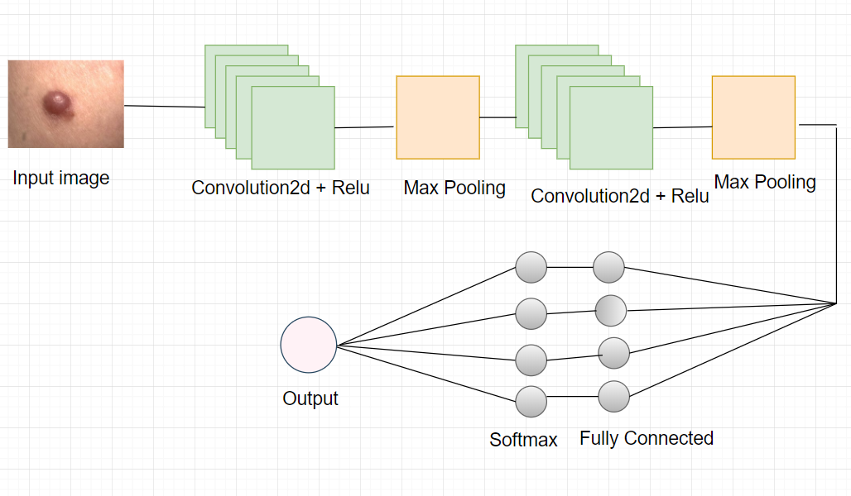
CNN Architecture

Slide 20
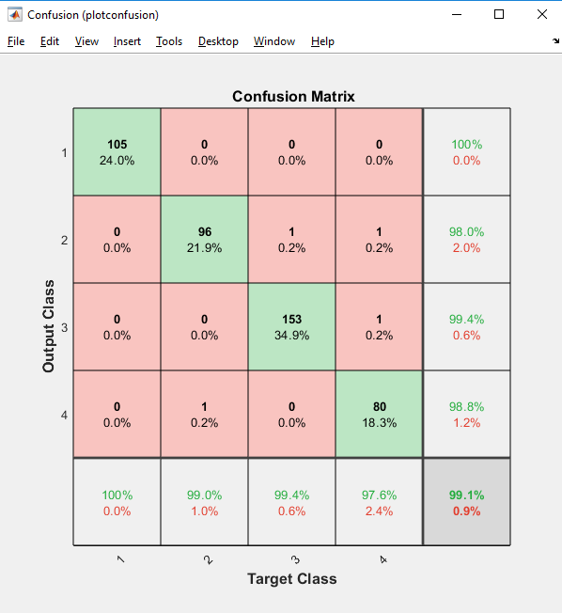
Comparison: Confusion Matrix CNN

Slide 21
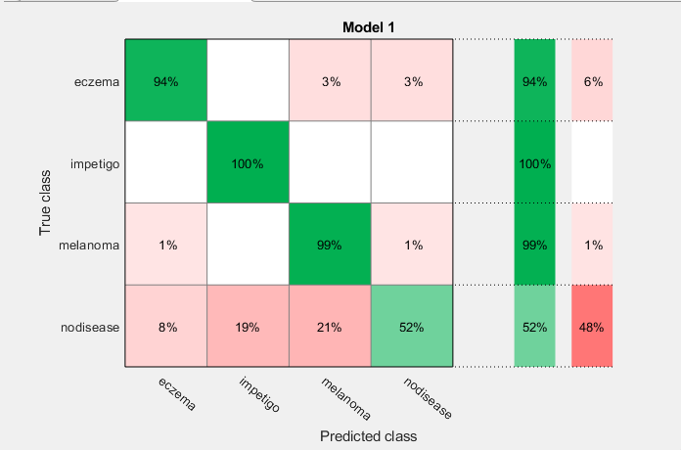
Confusion Matrix SVM:

Slide 22
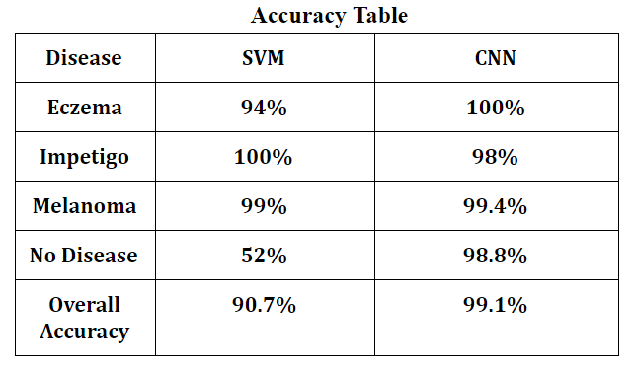
Results:

Slide 23
Conclusion:
This Paper gives the solution for detecting 3 skin diseases i.e melanoma, eczema, impetigo using Image Processing with SVM classifier and CNN classifier. Comparison between CNN and SVM Classifier is done with the help of confusion matrix and the detailed table showing accuracy of both the classifiers. According to the result obtained, CNN classifier proved to be accurate and efficient in detecting the skin disease as compared to SVM Classifier.

Slide 24
Thank you

